Slide 1
Creating virtual groundwater research laboratories through interoperable technologies
Peter Dahlhaus, Helen Thompson, Kirsten McKenna & Rob Milne
Centre for eResearch and Digital Innovation (CeRDI)

Slide 2
CeRDI
eResearch
How do we provide access to big and complex data in a way that people can use easily… but without biasing the data?
How do we incorporate qualitative data and quantitative data into models and maintain accuracy?
How can we harness Citizen Science and include crowd-sourced data and maintain accuracy?
Can we use digital technologies to we ensure that we don’t keep repeating the same science?

Slide 3
CeRDI
End users, e.g. Browser, mobile application, desktop application, etc.
Used by: government, business, media outlet, researcher, farmer, citizen, etc.
Access, use, extension
Output as:
web services (W3C, OGC compliant)
Input as:
Data, map layers, grids, text and imagery in native format (or web services)
Organisation data
Groundwater data
Geological data
Soil data
conversion
Data, information
Crowd sourced data
Third party, e.g. State agencies, research organisations, consultancies, business, etc.

Slide 4
CeRDI

Slide 5
CeRDI
Participants
Geological Survey of Canada (GSC), Canada
United State Geological Survey (USGS), USA
Commonwealth Scientific and Industrial Research Organisation (CSIRO), Australia
European Commission, Directorate General – Joint Research Centre (JRC), European Union
Federation University Australia (FedUni), Australia
Geological Surveys of Germany (GSG), Germany
British Geological Survey (BGS), U.K.
Bureau de Recherche Géologiques et Minières (BRGM), France
International Groundwater Resources Assessment Centre (IGRAC), UNESCO
Salzburg University (U Salzburg), Austria
Bureau of Meteorology (BoM), Australia
Polish Geological Institute (PGI), Poland

Slide 6
CeRDI
Groundwater Markup Language - GroundWaterML2.0 (GWML2) is designed to enable a variety of data exchange scenarios. These scenarios are captured by its five motivating use cases, including:
(1) a commercial use-case focused on drilling water wells with knowledge of aquifers,
(2) a policy use case concerned with the management of groundwater resources,
(3) an environmental use-case that considers the role of groundwater in natural eco-systems,
(4) a scientific use-case concerned with modeling groundwater systems, and
(5) a technologic use-case concerned with interoperability between diverse information systems and associated data formats.

Slide 7
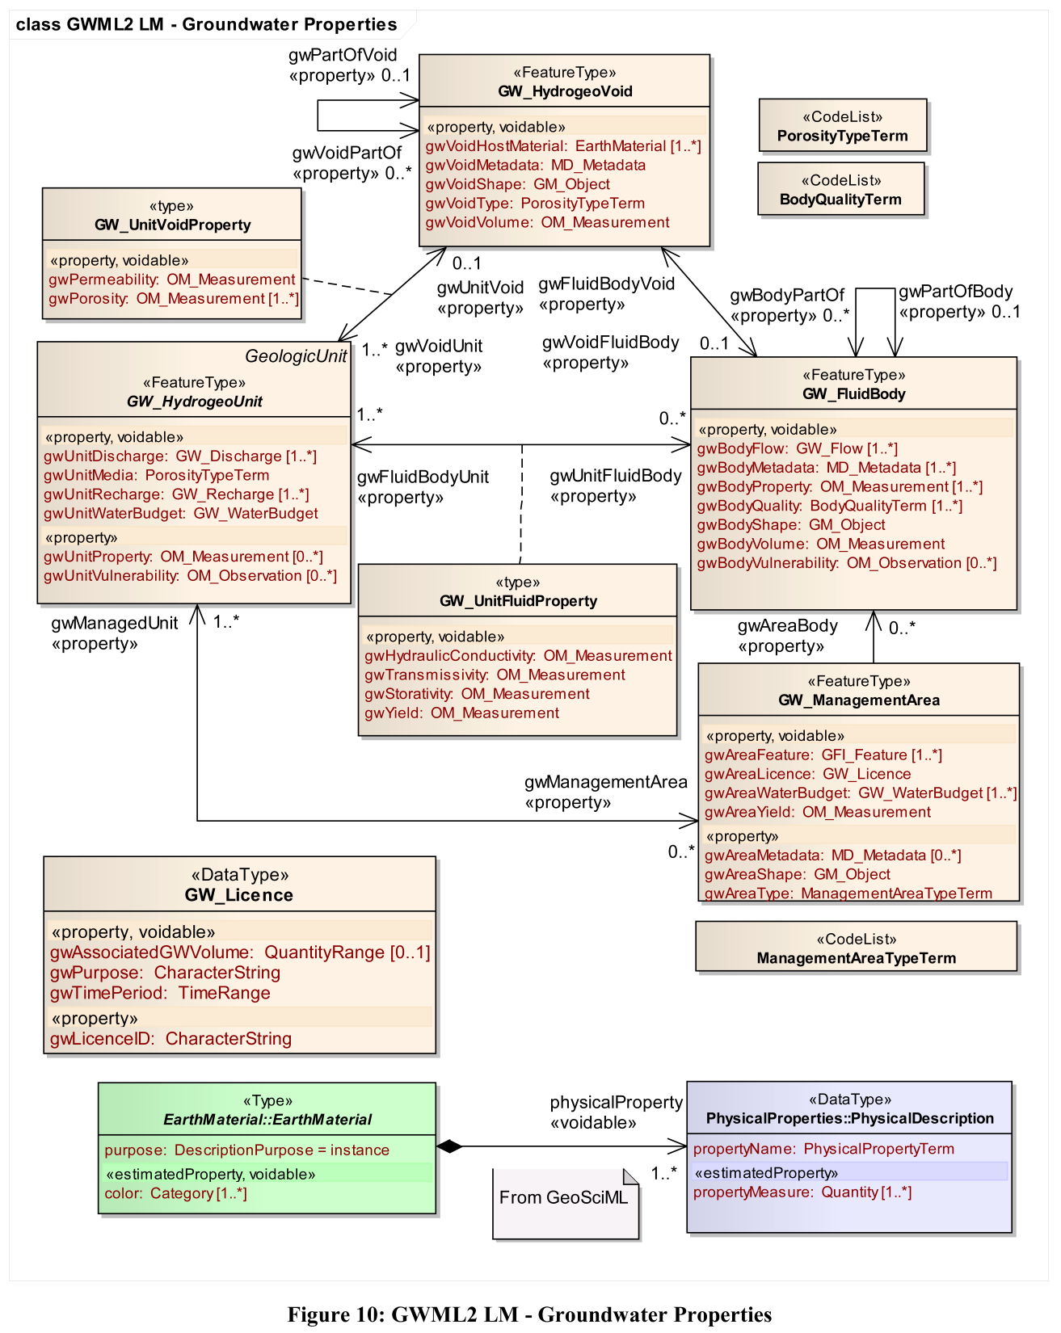
CeRDI
The GroundWaterML2 schemas are organized into 5 modular packages:
(1) Nucleus: core elements such as aquifers, their pores, and fluid bodies.
(2) Constituent: the biologic, chemical, and material elements of a fluid body.
(3) Flow: groundwater flow within and between containers.
(4) Well: water wells, springs, and monitoring sites.
(5) WellConstruction: the components used to construct a well.

Slide 8
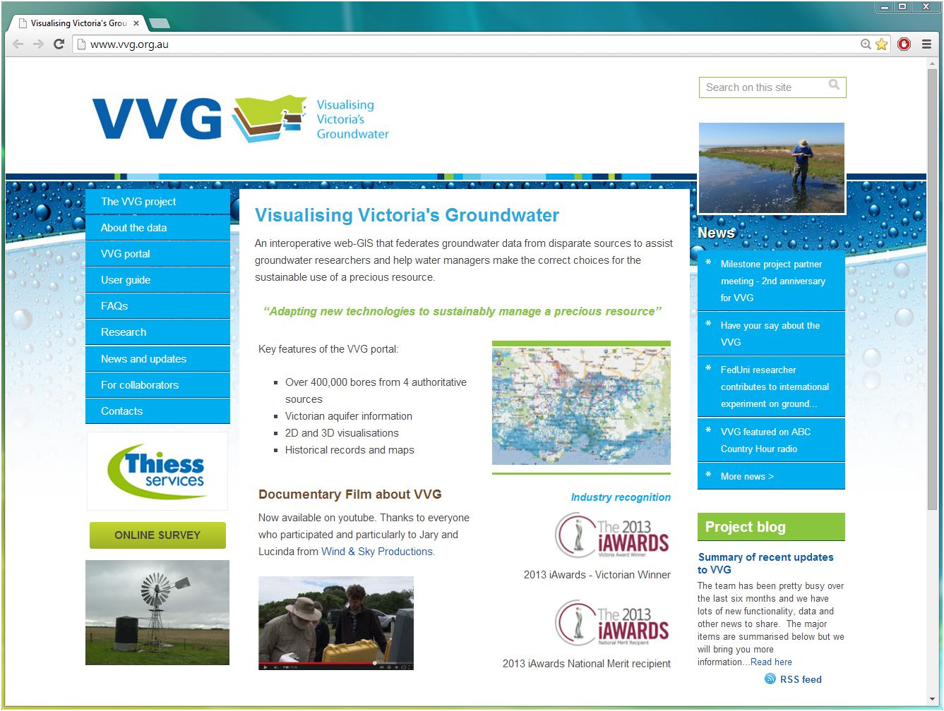
CeRDI
www.vvg.org.au

Slide 9
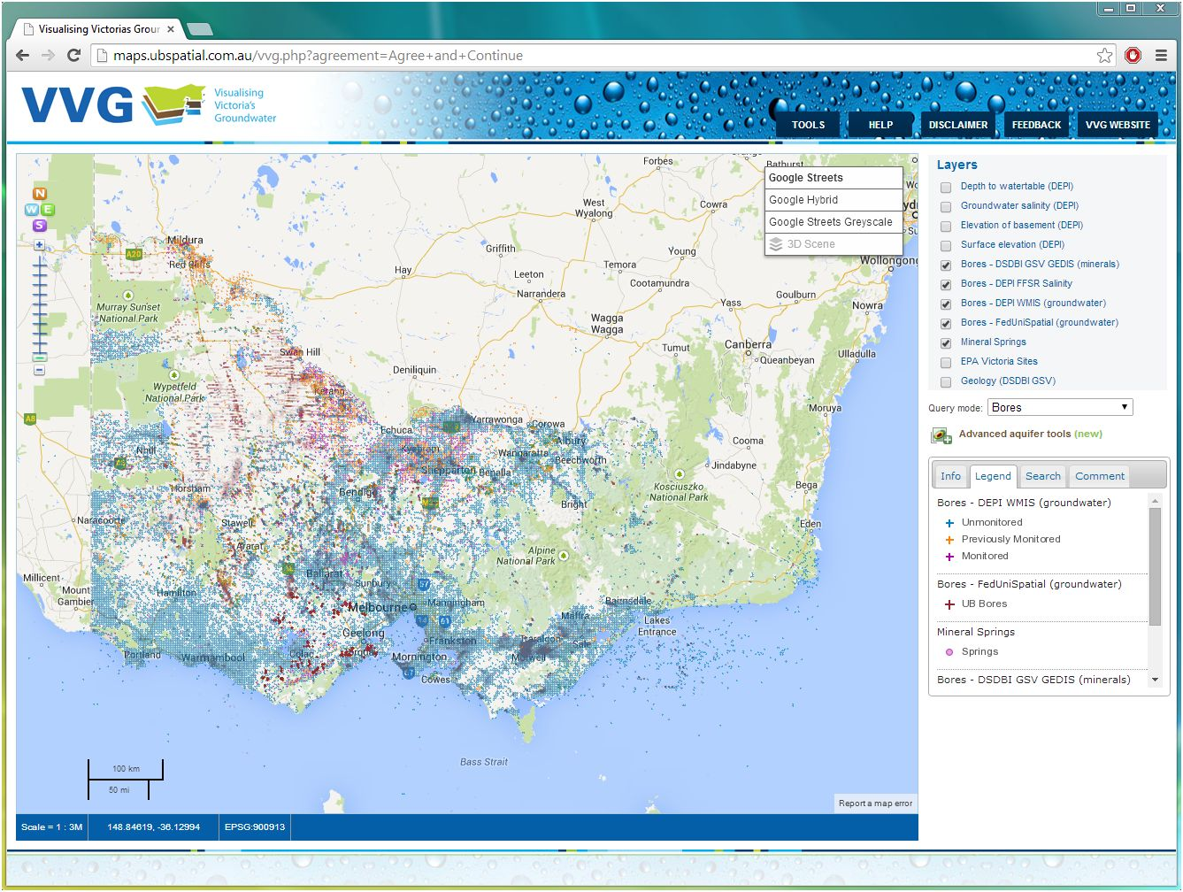
Bores from 4 different databases + springs

Slide 10
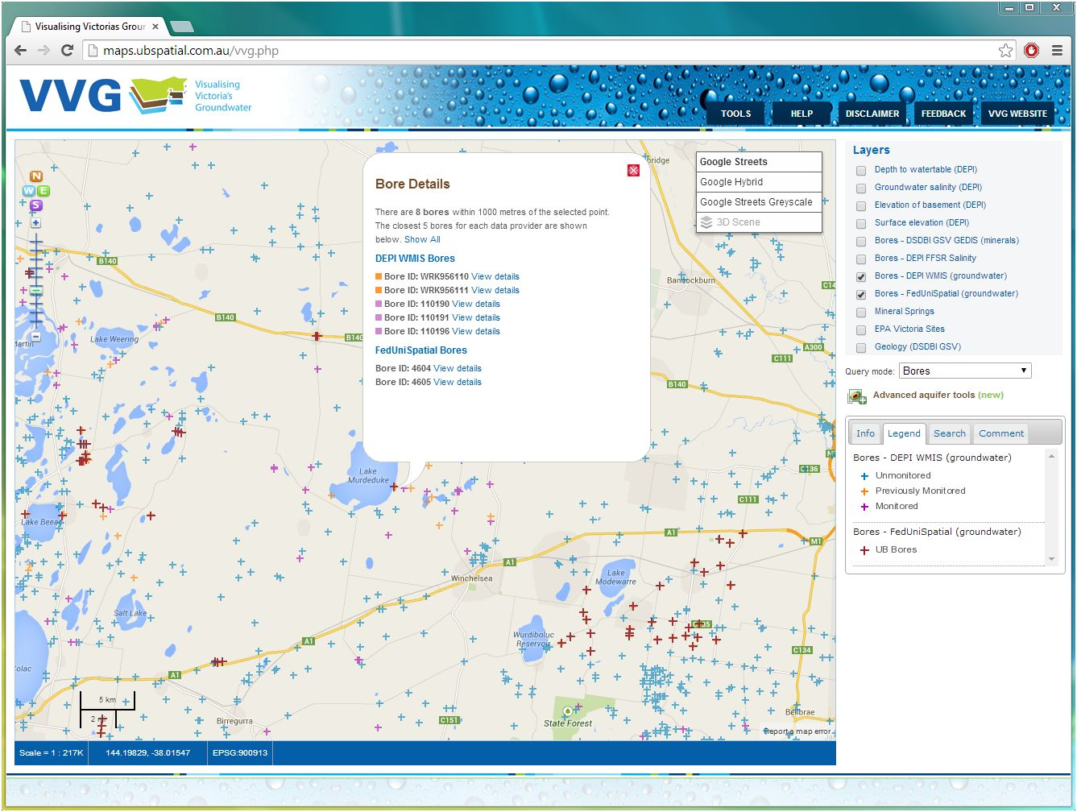
Links to bore data

Slide 11
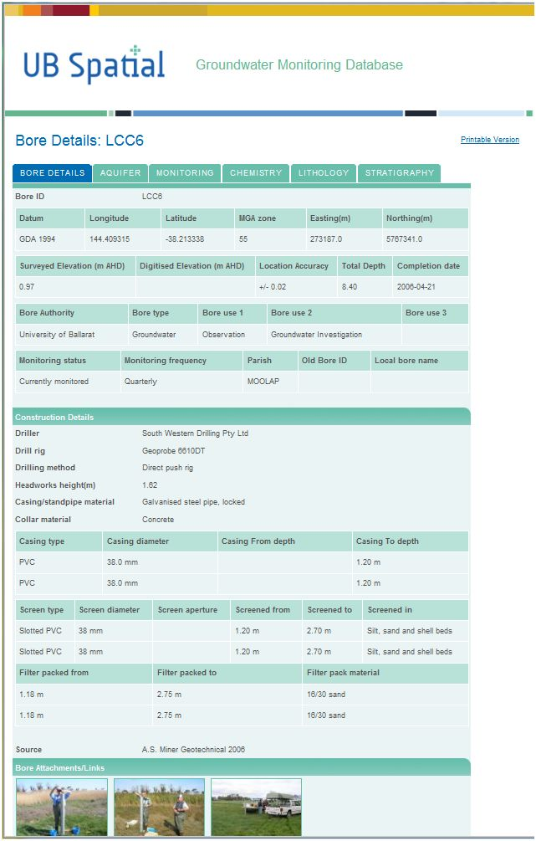
Bore location & construction
Aquifer parameters
Waterlevel monitoring
Groundwater chemistry
Bore lithology
Stratigraphy
Links to:
Photos
Documents
Maps & sections

Slide 12
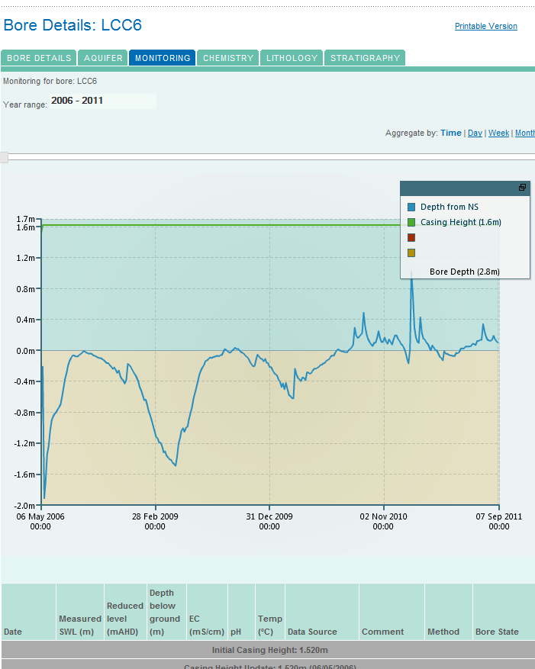
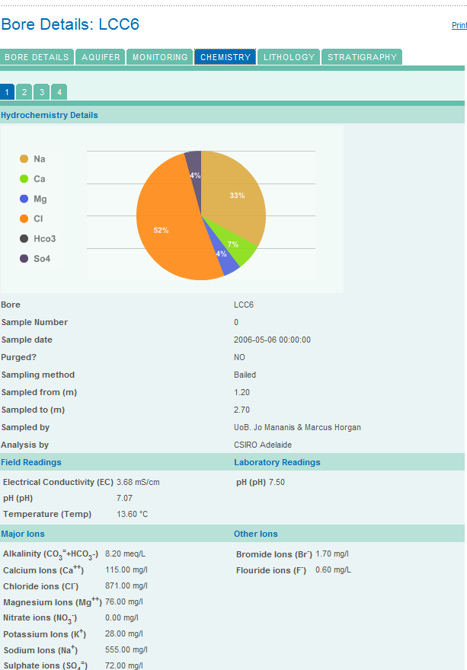
Groundwater chemistry
Waterlevel monitoring

Slide 13
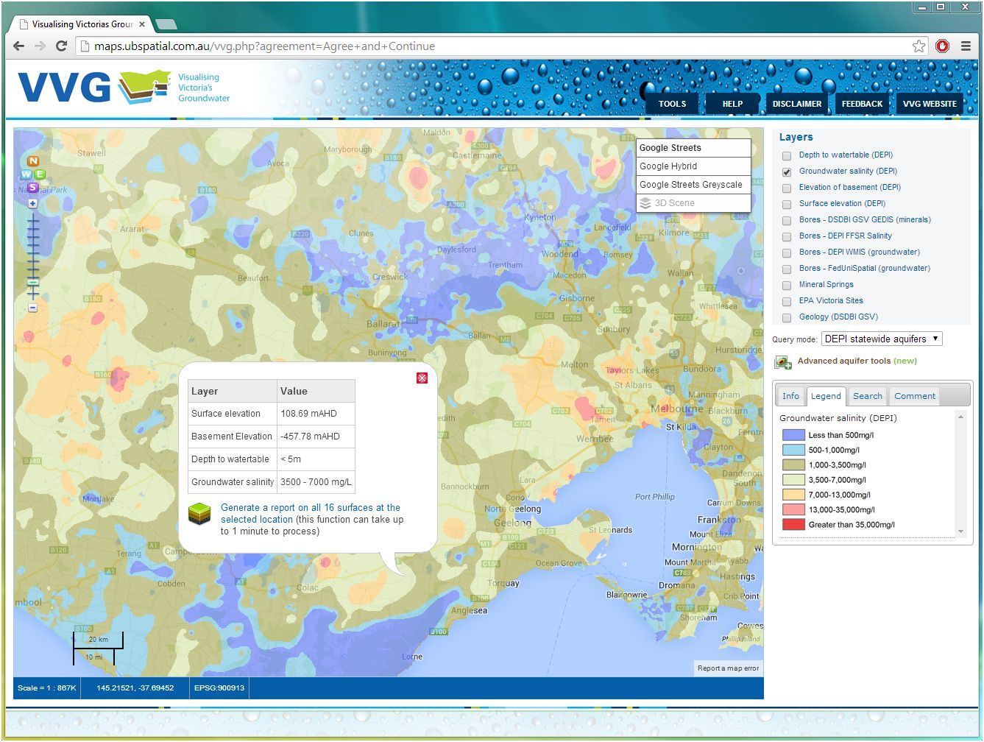
Predictions of depth to watertable, groundwater quality, surface elevation and basement elevation
e.g. ground-water salinity

Slide 14
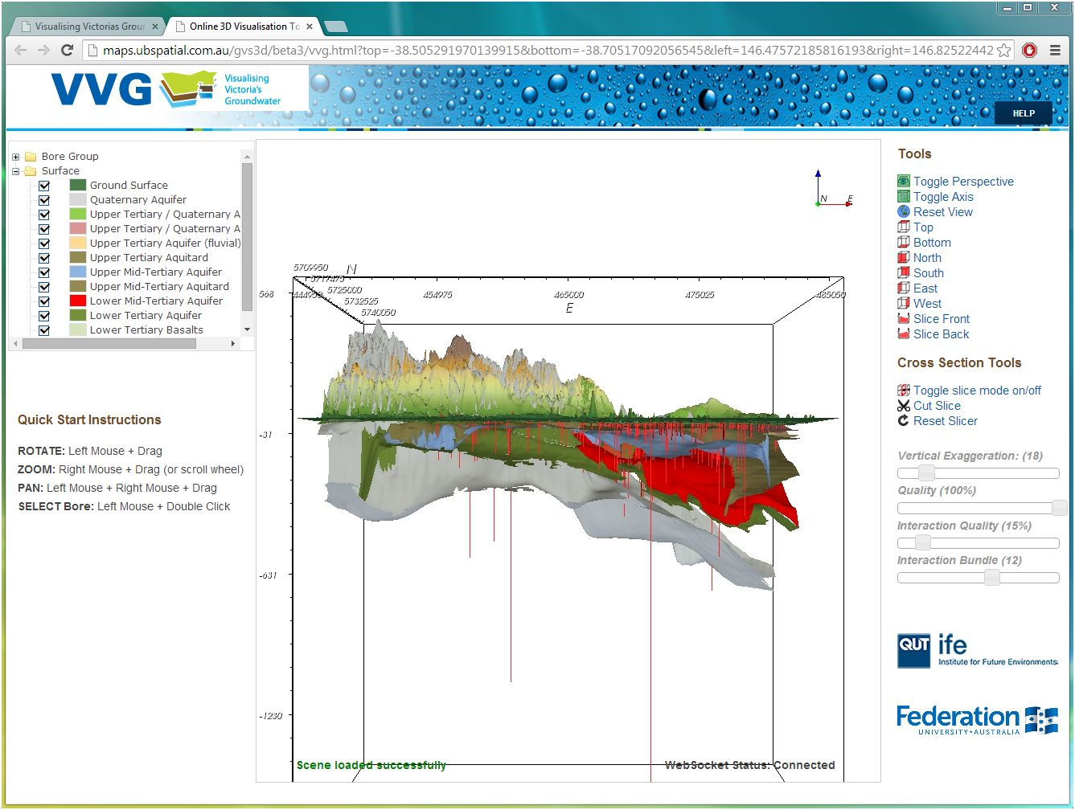
CeRDI
Interactive 3D views

Slide 15
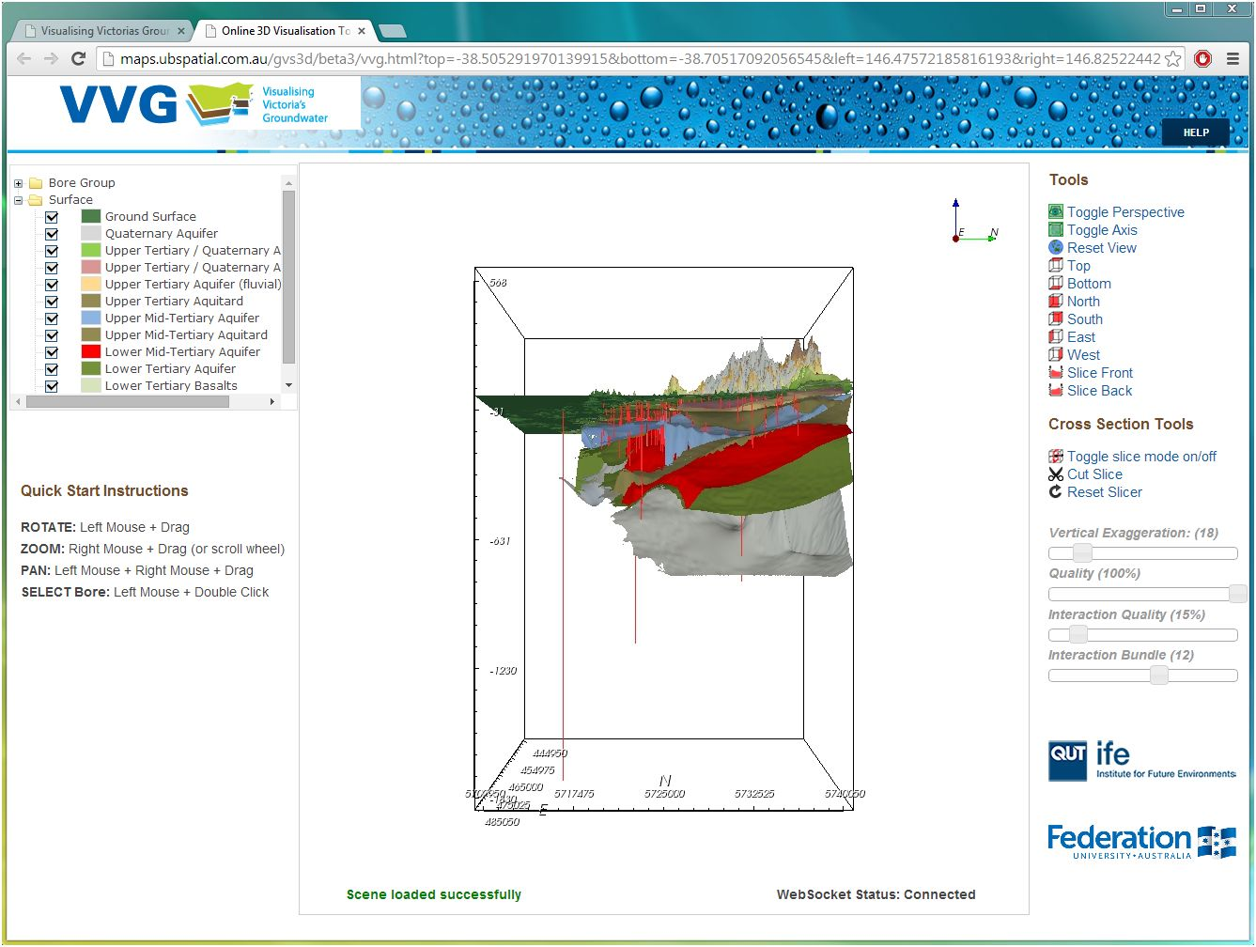
CeRDI

Slide 16
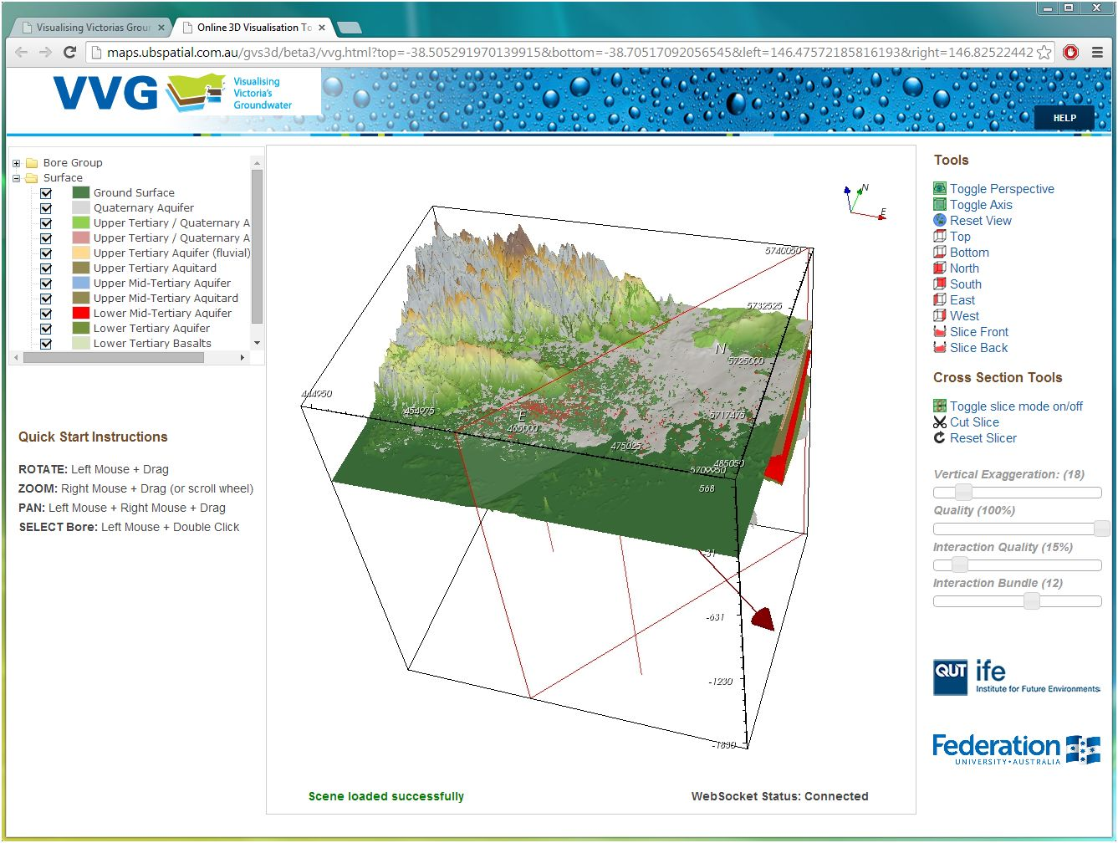
CeRDI
Cross-section tool

Slide 17
CeRDI

Slide 18
CeRDI

Slide 19
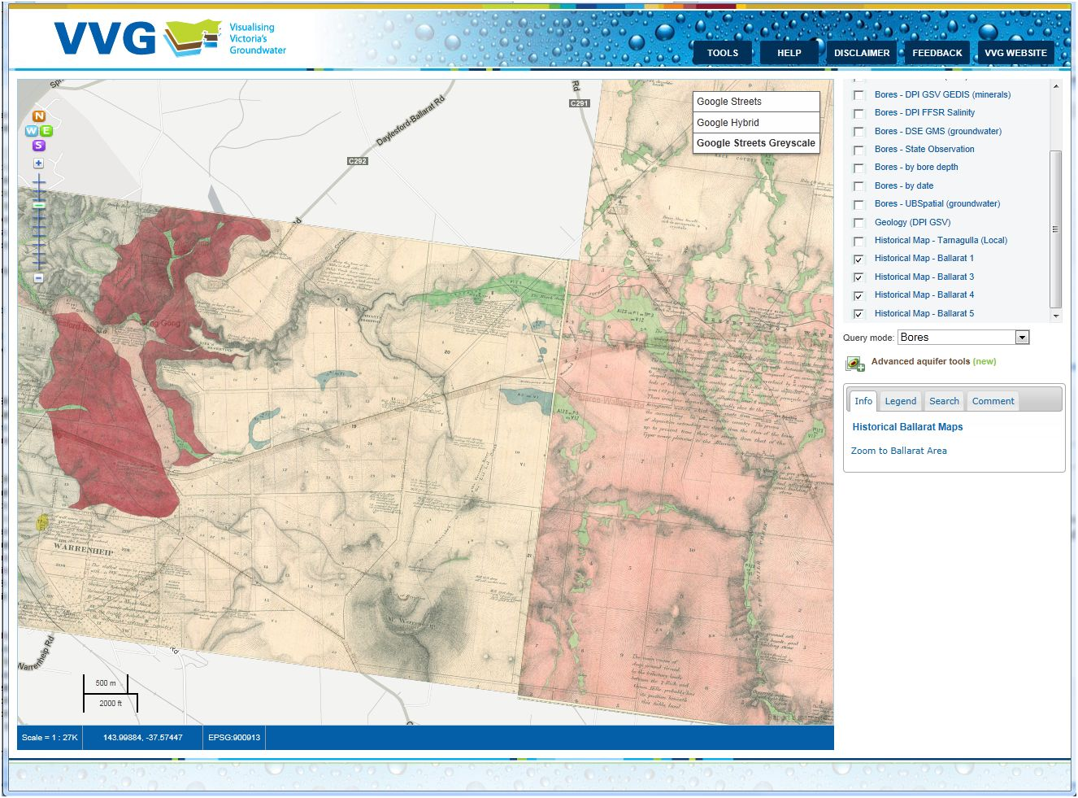
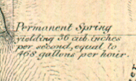
Access to rare spatial data
(e.g. Ballarat Water Board maps from 1870)

Slide 20
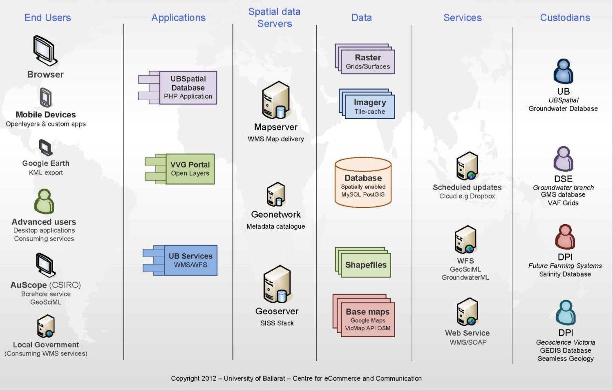
function
System architecture

Slide 21
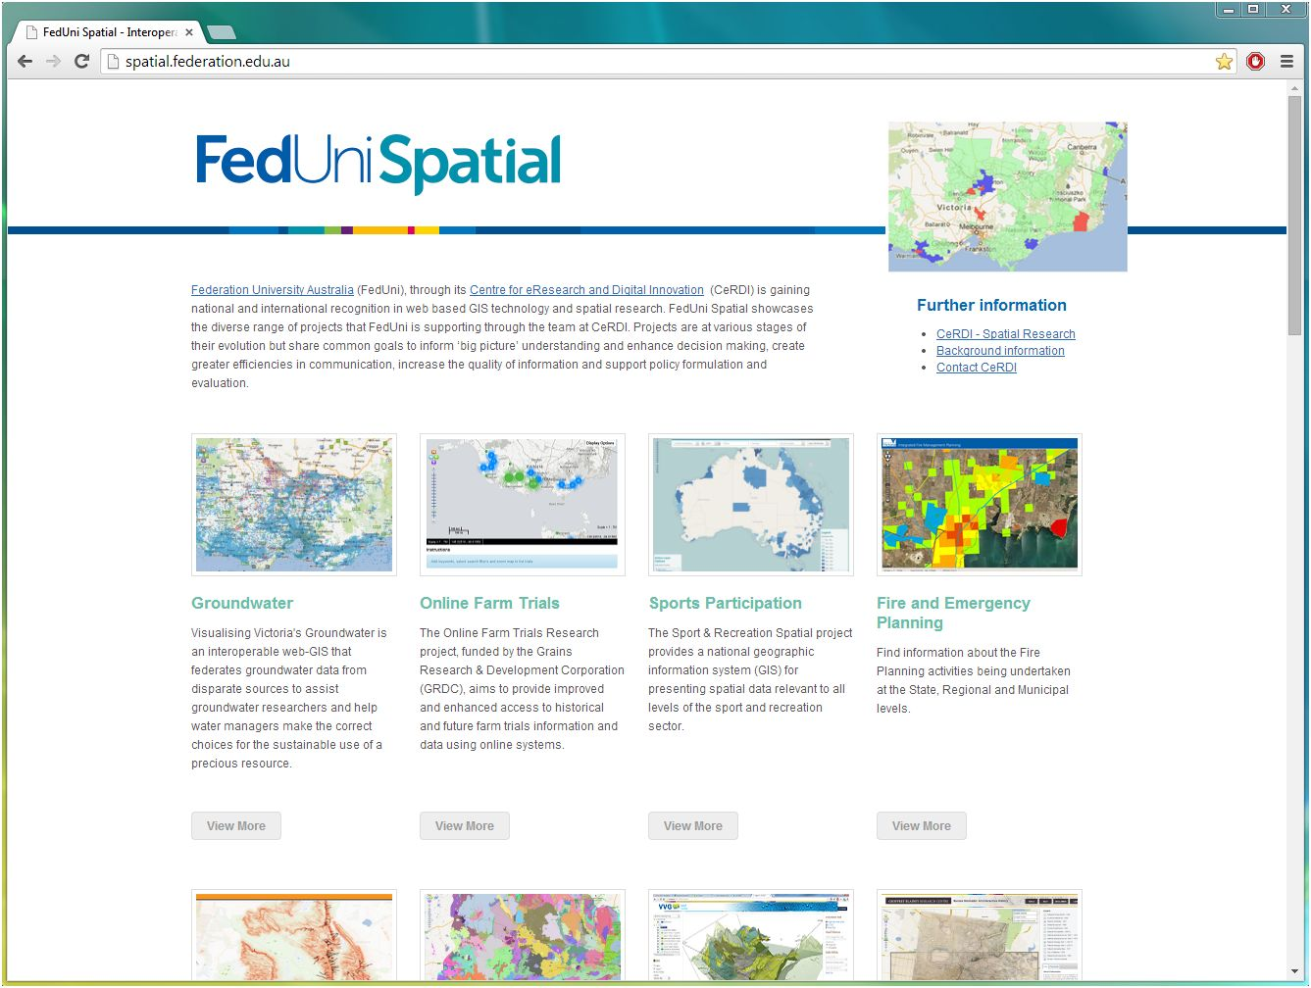
CeRDI
spatial.federation.edu.au
Branching into other data sets:
soils, agriculture, biodiversity, fire, history, etc.
Allows integration of cross-disciplinary data sets
New discoveries

