Slide 1
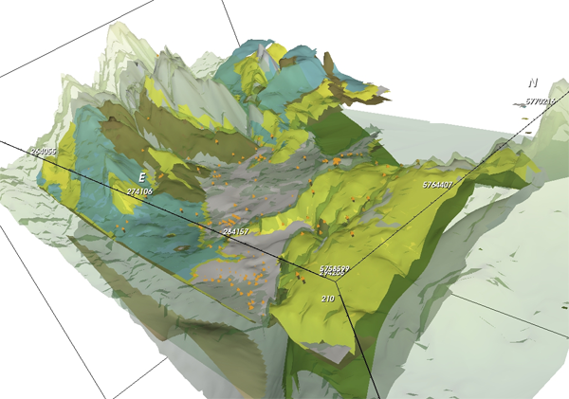
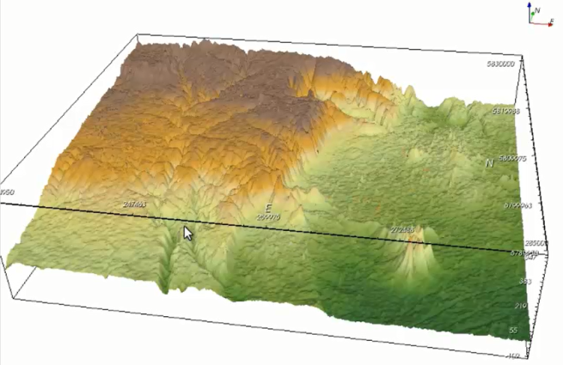
Web-based visualisation of 3D Groundwater models
Andrew MacLeod, Peter Dahlhaus & Helen Thompson
University of Ballarat, Mt Helen, Victoria, Australia
Allan James and Malcolm Cox
Queensland University of Technology, Brisbane, Queensland, Australia
Notes:
Acknowledge co-authors Peter, Helen, Particularly Allan and Malcolm
QUT – institute for future environments
My Background – computer science (not a hydrogeologist). Web development, databases and information management and delivery
I work for a centre which deals mainly in eResearch, applying technology and tools to improve information delivery decision making
Talk split into 2 parts. A bit of background on the VVG project to provide context
Demonstration of the 3D visualisation platform we have developed collaboratively with QUT

Slide 2
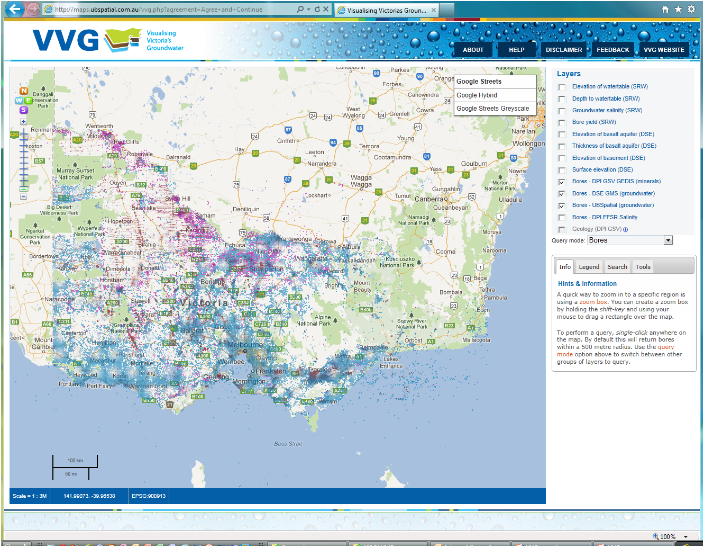
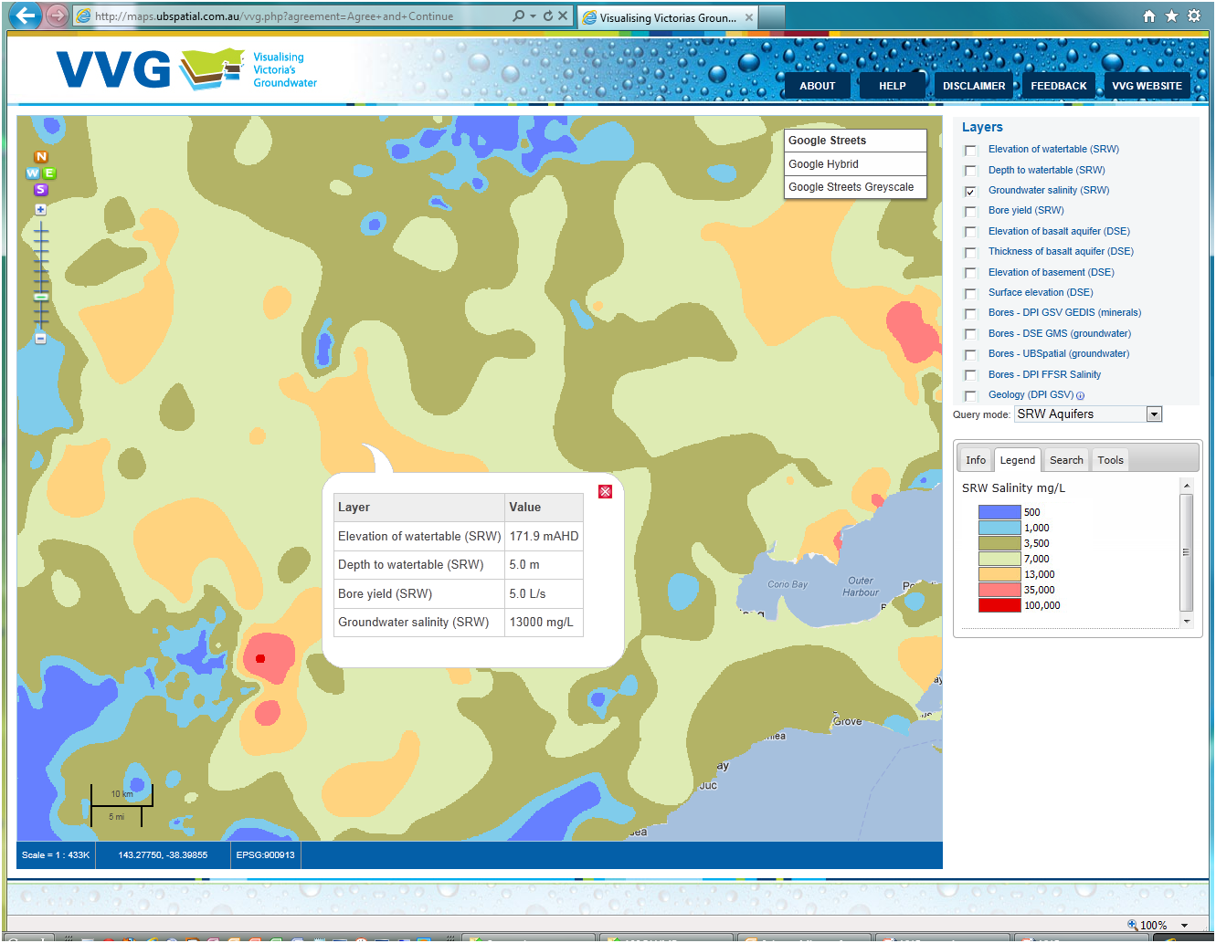
Background
VVG is an interoperable web-GIS that federates groundwater data from disparate sources to assist water managers make the correct choices for the sustainable use of a precious resource
www.vvg.org.au
Notes:
Ill just provide a bit of background on the Visualising Victoria’s Groundwater project which I have been involved with over the last 2 years.
Essentially the goal was to bring together/federate all the groundwater information for Victoria. We knew the Canadians had achieved this through the GIN so we knew it was possible. We knew the history/fractured state of groundwater information in Victoria and saw that as a University we could potentially fill a need. We had developed relationships with a number of important stakeholders and we put together a truly collaborative project.

Slide 3
Partners
Notes:
Mention the state data custodians/providers (government departments)
NRCanada for the vision
CSIRO technology. SISS Stack
Users: Water authorities, consultants
Various collaboration with other Universities

Slide 4
Interoperable: a data consumer
VVG Portal
Groundwater Bores – GMS (DEPI)
Exploration Bores (Geoscience VIC)
Salinity Research Bores FFSR (DEPI)
Mineral Springs (VMWC)
Victorian Aquifer Framework - SAFE (DEPI)
Seamless Geology (GeoScience VIC)
Digitised historical records (SLV)
3D Visualisation Software (QUT)
Notes:
The data sources
DEPI - The Groundwater Management System, soon to become the WMIS
Victorian Aquifer Framework – Safe project 1.8mill project (in kind)
Geoscience Victoria – Seamless geology & GEDIS
DEPI – FFSR salinity research database

Slide 5
Notes:
This is the information architecture
Data custodians, data provision (best available)
Data types
Spatial data processing and delivery
Web-based interfaces/applications
End users

Slide 6
Web-based 3D visualisation
Traditional methods
VRML and X3D
Generally require a browser plugin
Natural Resources Canada – Groundwater Information Network (GIN)
Recent advancements
HTML5 and WebGL
Makes use of graphic processing capability of the viewing device
Once loaded, interactivity is excellent
Notes:
Ok, so a bit of background on 3D on the web.
The web wasn’t really designed for this kind of information delivery.
The traditional method generally involved the use of 3rd party plugins or add-on software. There are some great examples of this kind of technology and the Canadian GIN example was our inspiration and benchmark for user experience.
Over recent years, there has been a significant change in the capability of web browsers through support for HTML5.
Highly interactive and immersive. We have been playing with this technology for bore construction diagrams and interactive water chemistry plots.
Limitations on the complexity and size of the data models

Slide 7
The solution: a marriage
GVS Web
Viewing Device
Desktop
Tablet
Mobile
Surface
High-end GPU
Provides Image stream
Web Portal
Web-based interface
HTML5 web sockets
Server based rendering
Groundwater Visualisation System (GVS)
Powerful, desktop based system
Based on open source technology
Visualising Victoria’s Groundwater (VVG)
Intuitive, web-based delivery system
Based on open source technology
The marriage
Web-based access via 2D map (VVG)
Rendering occurs on a remote server (GVS)
Image stream delivered from server to browser
HTML5 web sockets to provide real-time interactivity
Low latency, full duplex communication
No processing requirement on the end user device
Notes:
We had seen the GVS system through the wonderful fly-through videos on the GVS website. The capabilities were far more than we had seen to date. The fact that the system was based on open source technology lead us to meet with Mal and Allan and I guess we got their combined brains thinking about how we could web-enable the GVS through a web-interface like VVG. Allan James is responsible for the concept we came up with and for the lion share of development. So the architecture we came up with used some new browser capabilities through HTML5 web sockets to create a communication channel between the end users browser and the GVS running on a high-end server GPU. As the user moves the mouse and interacts with the scene, the communication channel sends requests to the GVS to render the adjusted scene and it sends back and image stream to the browser. It ends up like a video of numerous image frames being sent to the browser from the server. We don’t need any processing power on the end user device.

Slide 8
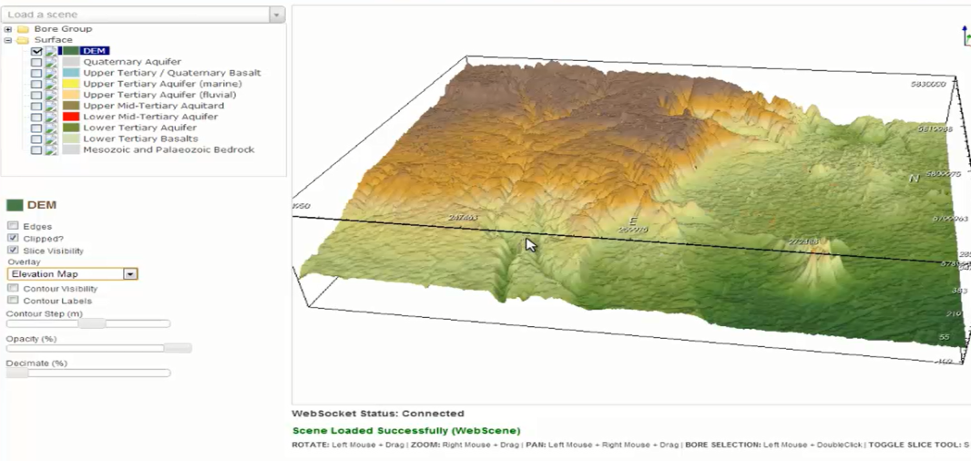
Demonstration video

Slide 9
What’s next
Scalability and speed
Number of simultaneous users
Size and complexity of models
Number of dynamically loaded features
Loading features and surfaces via web service (WMS, WFS, WCS, TMS)
Exposing more functionality
Water level animations
Hydrographs
2D cross sections
Modelling on-the-fly
Improving the data

Slide 10
Thankyou
Primary funding supplied by the State Government of Victoria
Broadband Enabled Innovation Program (BEIP)

